Slide 1
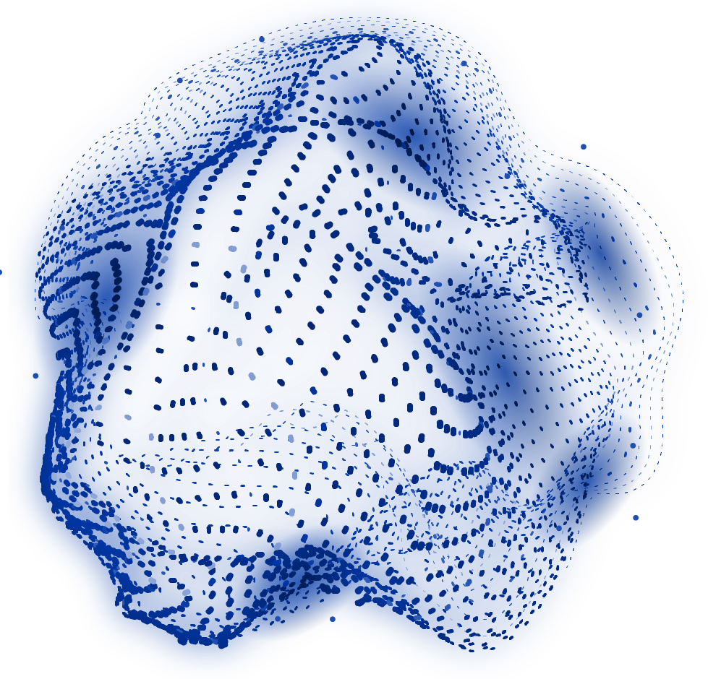
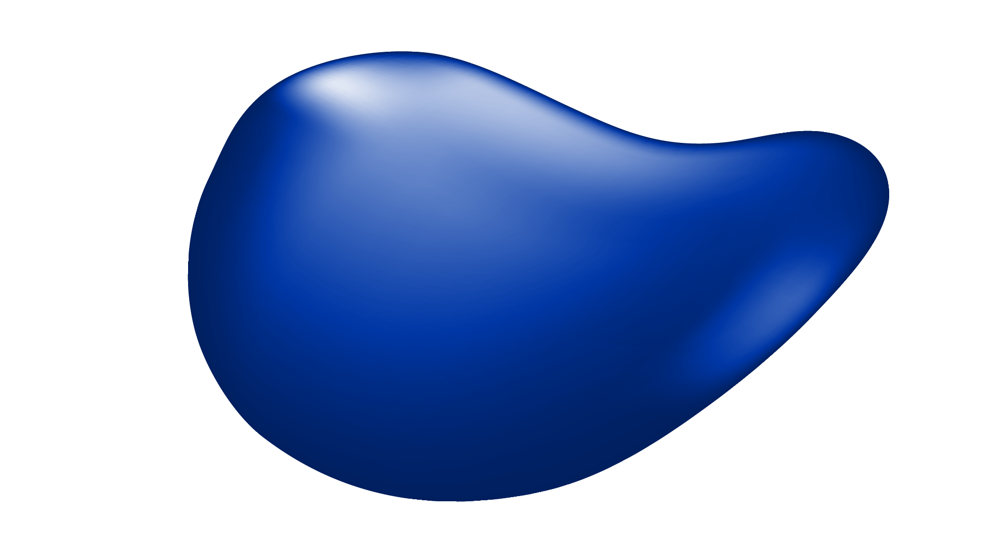
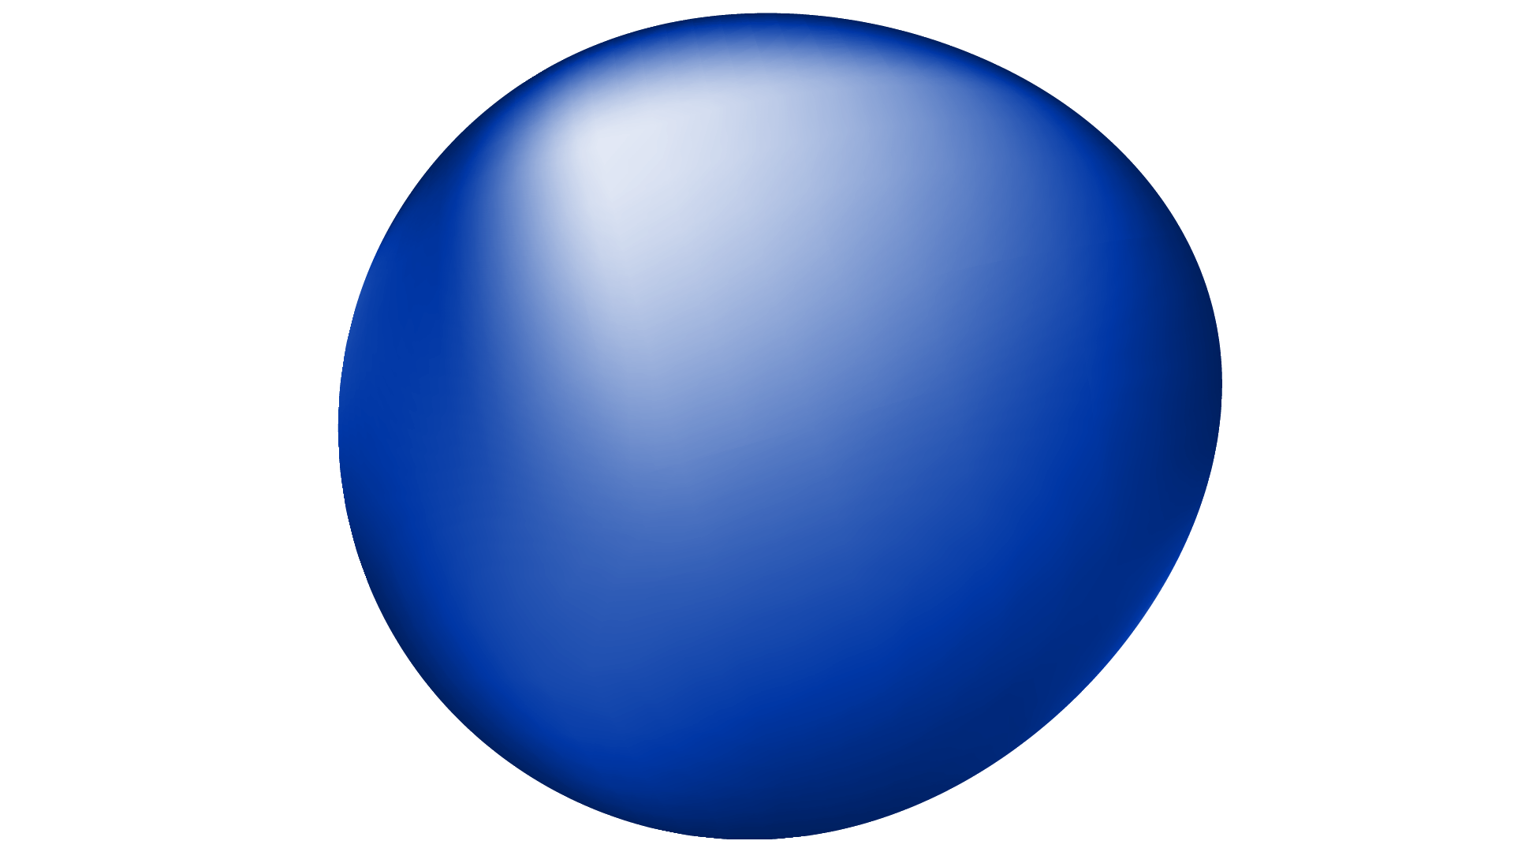
MultiModel ARTIFICIAL INTELLIGENCE (AI)
Artificial Intelligence 2
Presented By:
Abdelkarim Douadjia

Slide 2

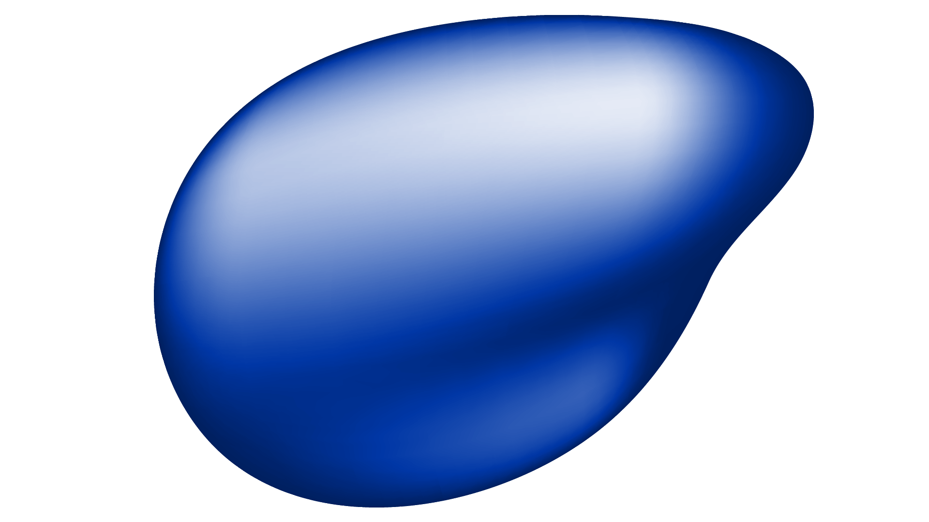
Presented By
ABDELKARIM DOUADJIA
Master 1 AI

Slide 3
TABLE OF CONTENTS
01
02
03
04
05
What is Multimodal AI?
Why Multimodal AI?
Key Components of Multimodal AI
Applications of Multimodal AI
Challenges in Multimodal AI

Slide 4
TABLE OF CONTENTS
07
08
09
10
06
Sign Language Recognition: A Multimodal AI Application
Project Overview
Technical Approach
Demo
Conclusion

Slide 5
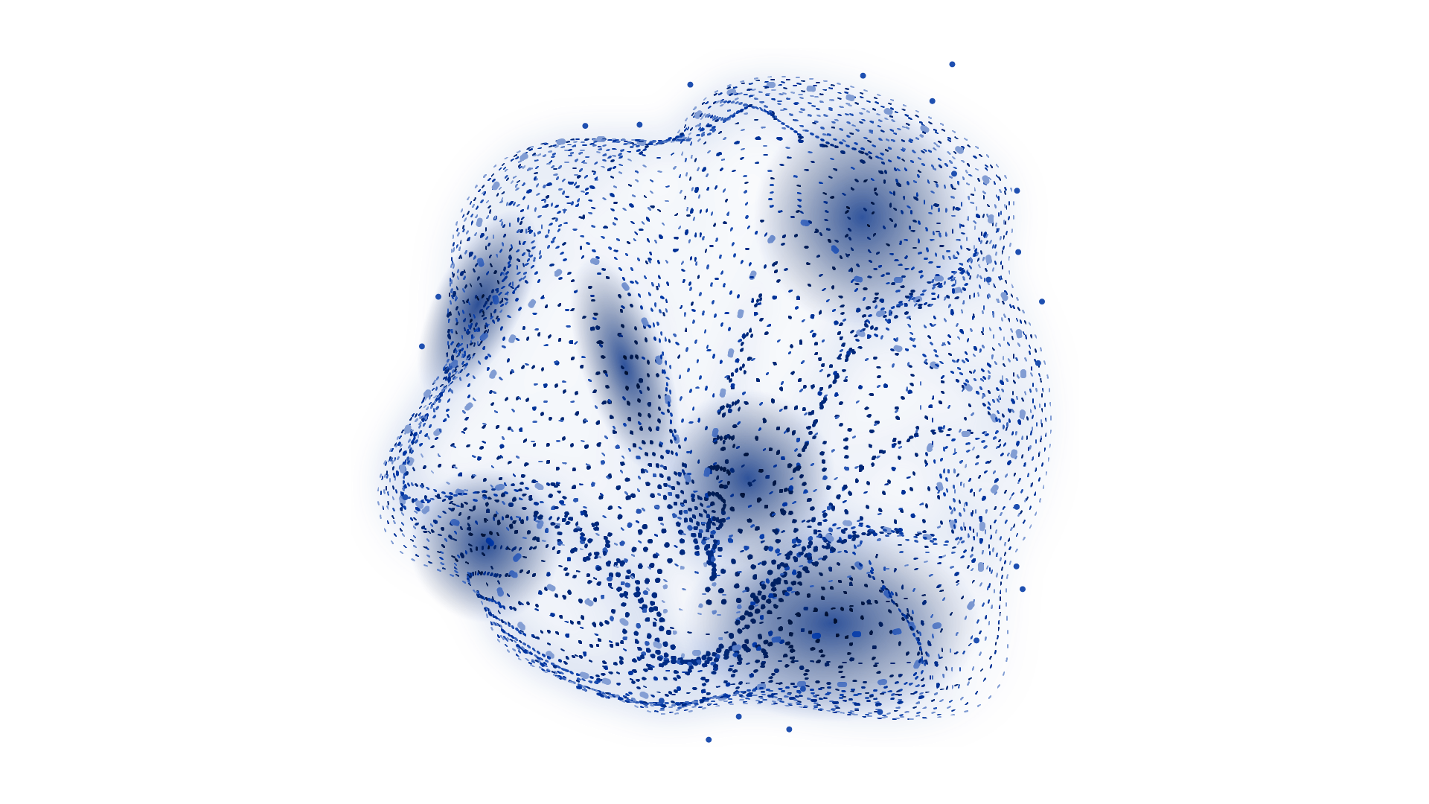
01
What is Multimodal AI?

Slide 6
What is Multimodal AI?
Definition: Multimodal AI integrates data from multiple modalities (e.g., text, images, audio, video) to achieve a task.
Key Idea: It combines the strengths of different types of data to create smarter, more capable systems.
Why It Matters:
Single sources of data can be limited or incomplete. Multimodal AI fills in the gaps.
It provides richer insights by understanding how different data types relate to each other.
Examples:
Text + Images: Generating captions for pictures.
Audio + Video: Recognizing speech with lip-reading support.
Sensors + Visuals: Combining LIDAR and camera feeds for autonomous cars.

Slide 7
02
Why Multimodal AI?

Slide 8
Why Multimodal AI?
Enhanced Understanding: By using different data types together, it captures more complete information about the world.
Improved Reliability: If one data type is unclear or noisy, the others can fill in the blanks.
Real-Life Applications: Many challenges in AI, like speech translation or gesture recognition, require more than one type of input.
Richer Interactions: Systems like virtual assistants become more interactive by using both speech and facial cues.
Examples in Action:
Healthcare: Combining medical history with imaging for better diagnostics.
Entertainment: Synchronizing character animation with voice input for realistic avatars.

Slide 9
03
Key Components of Multimodal AI

Slide 10
Key Components of Multimodal AI
1. Data Fusion:
Bringing together inputs from various sources to make sense of the full picture.
Example: Combining camera views and audio feeds in video conferencing tools.
2. Feature Representation:
Turning different types of data into machine-readable formats. For instance:
Images are processed by Convolutional Neural Networks (CNNs).
Text is encoded by Recurrent Neural Networks (RNNs) or Transformers.
3. Learning Architectures:
Models that process and align data from multiple modalities. Examples include attention-based networks and hybrid architectures.
4. Cross-Modality Interaction:
Aligning and connecting inputs, such as matching lip movement in videos to spoken words.

Slide 11
04
Applications of Multimodal AI

Slide 12
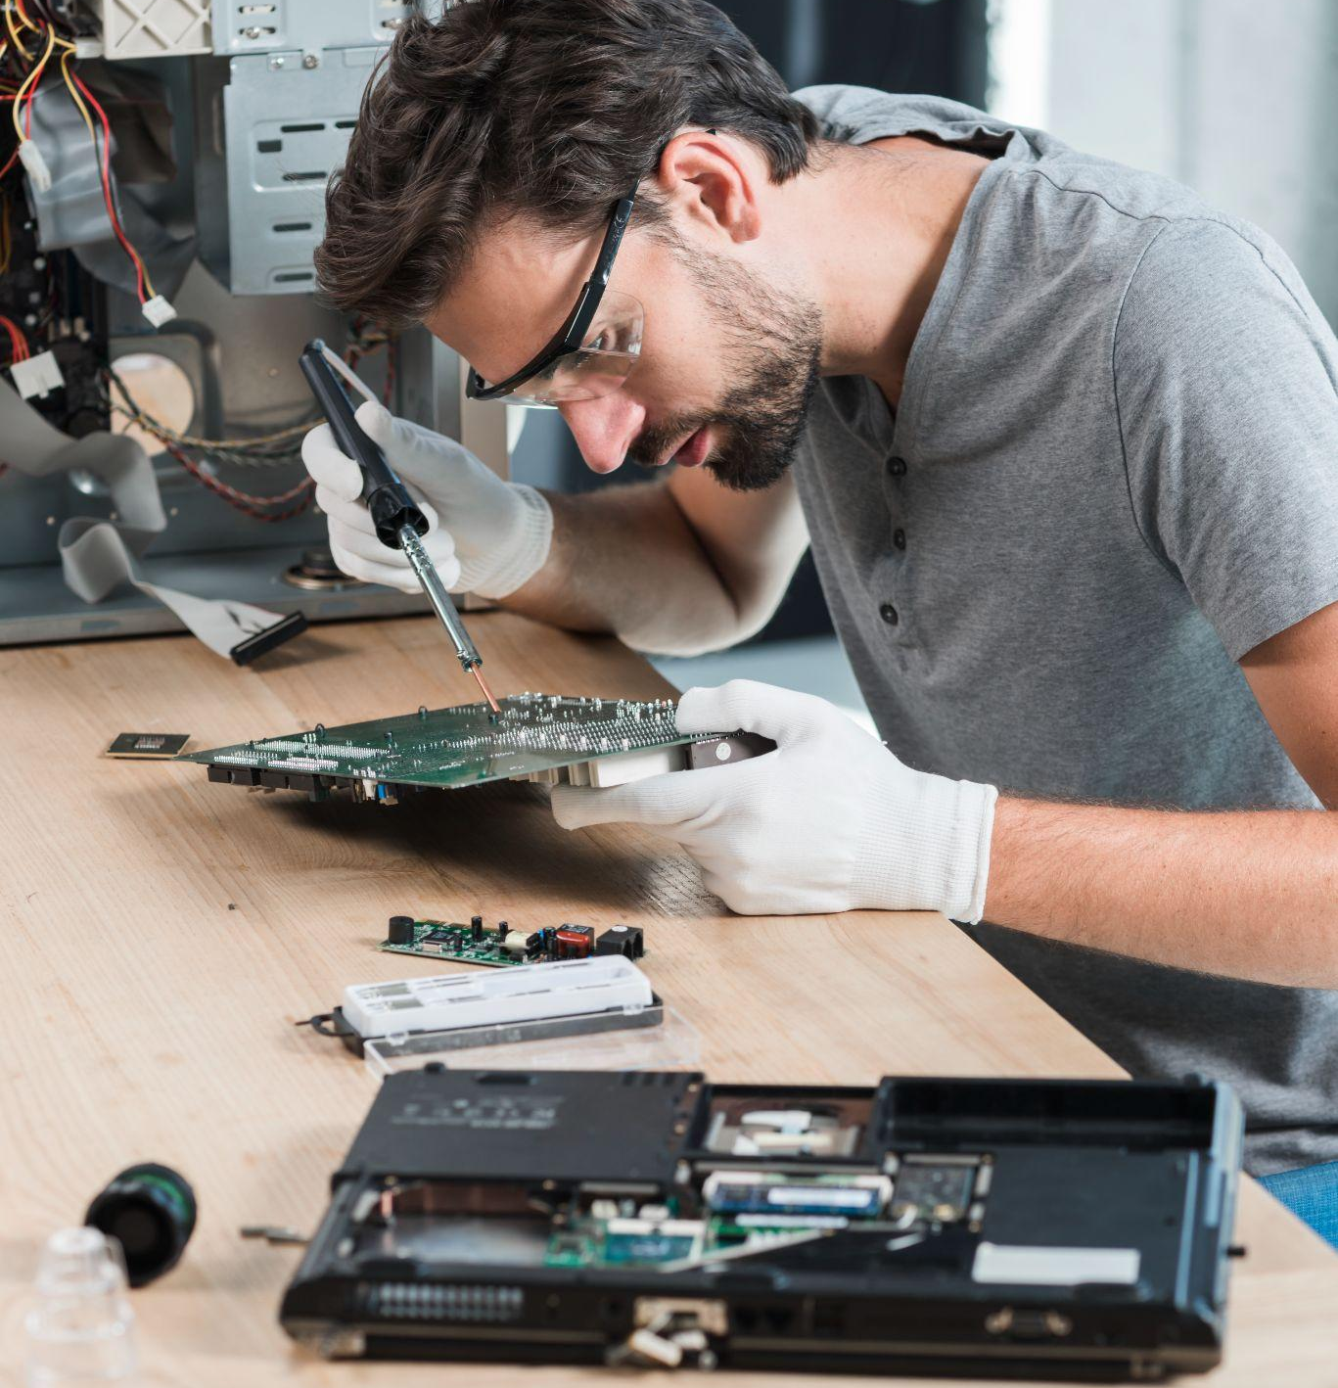
Applications of Multimodal AI
1. Healthcare:
Using CT scans, patient records, and lab results for diagnosing diseases more accurately.
AI systems that can combine these sources are helping detect conditions like cancer earlier.
Accessibility:
Translating spoken words into sign language using video and audio.
Assisting visually impaired users by describing images or surroundings.

Slide 13
Applications of Multimodal AI
Entertainment:
Generating lip-synced animations for gaming and virtual reality.
Combining soundtracks and visuals for improved storytelling.
4. Autonomous Vehicles:
Fusing GPS, LIDAR, and camera data to navigate safely.
5. Artificial Evolution (Husbands et al., 1997):
Virtual assistants that understand gestures alongside spoken commands.

Slide 14
05
Challenges in Multimodal AI

Slide 15
WHAT ARE WE WORKING ON?
Data Collection:
Complex Models:
Data Imbalance:
Gathering aligned and diverse datasets can be expensive and time-consuming.
Architectures that handle different data sources tend to be resource-intensive.
One data source may have more examples than another, creating biases.

Slide 16
OUR ASPIRATIONS
Synchronization:
Interpretability:
Keeping modalities aligned in time and space can be tricky, especially in video and audio tasks.
Understanding why a model made a decision becomes harder when using complex, multimodal inputs.

Slide 17
06
Sign Language Recognition: A Multimodal AI Application

Slide 18
Sign Language Recognition: A Multimodal AI Application Example
Objective: Recognize sign language by combining video and hand pose data.
Why Multimodal AI?
Multimodal AI involves using two or more data types to achieve a goal.
This project integrates:
Video Data: Captures overall motion, arm movements, and gestures essential for sign language.
Hand Pose Data: Provides precise details about finger positions and hand shapes by detecting landmarks like joints.
Impact:
Improves communication tools for people who are hearing-impaired.
Builds systems that bridge language gaps and promote inclusivity.
Real-World Potential:
Making real-time sign-to-speech translation possible.
Helping students and educators in sign language learning environments.

Slide 19
07
Project Overview

Slide 20

Sign Language Recognition: A Multimodal AI Application Example
Project Title: "Multimodal AI for Sign Language Recognition (Video + Hand Pose Estimation)"
Goal: Build a system that can recognize sign language using multimodal data.
Modalities Used:
Video Data:
Captures the dynamic movements of hands and arms.
Hand Pose Data:
Tracks key hand landmarks, like finger joints, for detailed recognition.
Potential Applications:
Translating sign language into spoken words or text in real-time.
Creating tools for better accessibility and communication.

Slide 21
08
Technical Approach

Slide 22
Technical Approach
1. Data Collection:
Bringing Custom data is recorded using a webcam.
Classes: 36 alphanumeric classes (A-Z, 0-9), 100 samples per class.
Script (collect_img.py): Captures live images from the webcam, organizing them into class-specific folders.
2. Preprocessing:
Use MediaPipe to detect hand landmarks from collected images.
Script (create_dataset.py): Processes images to extract normalized hand landmarks, saving them in a structured dataset.
3. Model Training:
Script (train_classifier.py):
Uses a Random Forest Classifier to train on the processed landmark data.
Splits data into train-test sets (80%-20%) to evaluate model performance.
Accuracy: Measures the percentage of correctly classified samples.

Slide 23
Technical Approach
4. Inference:
Script (inference_classifier.py):
Captures real-time video input via webcam.
Uses MediaPipe for hand landmark detection.
Runs the trained model to predict and display the recognized sign (A-Z, 0-9) in real time.
5. Visualization:
Real-time overlay of hand landmarks and bounding boxes on the video feed.
Displays the predicted character on-screen for better interpretability.

Slide 24
09
Demo Version

Slide 25
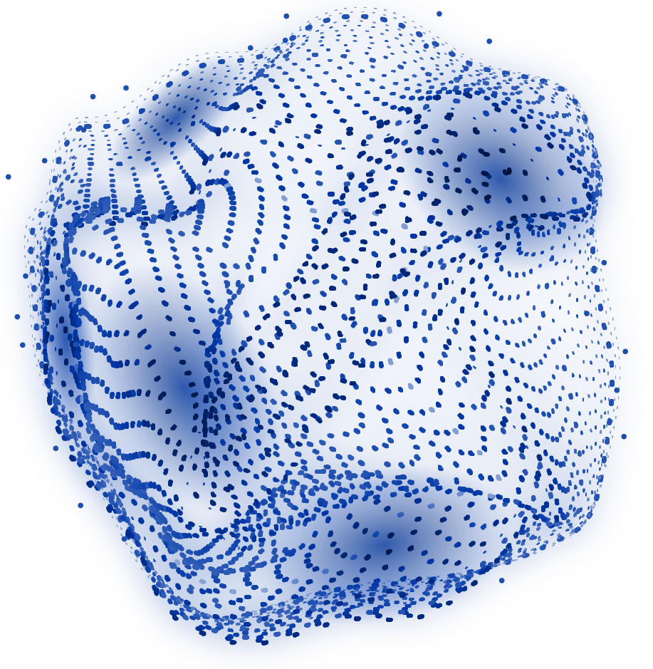
LIVE Demonstration

Slide 26
09
Conclusion

Slide 27
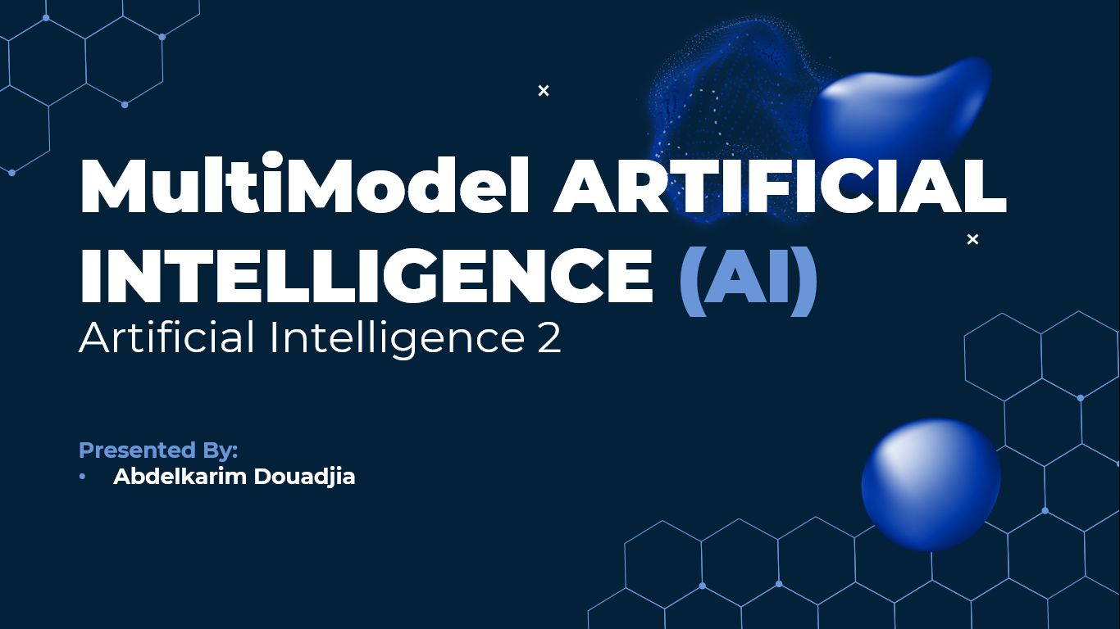
Conclusion
Summary:
Multimodal AI combines different types of data to create smarter and more capable systems.
Sign Language Recognition is a great example of how this technology can make a meaningful impact on accessibility.

Slide 28
Questions & Discussion

Slide 29
THANKS!
DO YOU HAVE ANY QUESTIONS?

